Slide 1

Graduate Project
Kofi Gyan
April 13, 2023
Notes:
Line spacing + Page numbers

Slide 2
Agenda
01 Introduction
02 Role of Machine Learning in Forensics
03 Process Outline
04 Results
05 Summary

Slide 3



Introduction
01
If you are an avid fan of crime shows you may have heard about the term blood drop splatter.
The reason why this term is used almost ubiquitously in crime shows is because the presence of blood at a crime scene can be very revealing in terms of providing criminal investigators with clues.

Slide 4
What is Machine learning?
01
Machine learning is a branch of computer science and artificial intelligence that uses data and algorithms to imitate the way that humans learn, improving accuracy over time.
Neural networks, also known as artificial neural networks (ANNs) are a subset of machine learning. Their name and structure are inspired by the human brain, mimicking the way that biological neurons signal to one another.
They comprise of node layers, containing an input layer, one or more hidden layers, and an output layer. Each node connects to another and has an associated weight and threshold.
If the output of any individual node is above the specified threshold value, that node is activated, sending data to the next layer of the network. Otherwise, no data is passed along to the next layer of the network.

Slide 5
What is a CNN?
01
Convolutional neural networks are distinguished from other neural networks by their superior performance with image, speech, or audio signal inputs. They have three main types of layers, which are::
Convolutional layer :
The convolutional layer is the first layer of a convolutional network.
Pooling layer
Fully-connected (FC) layer
Output layer.

Slide 6
What is a CNN?
01
Convolutional layer :The process of convolution involves a kernel or filter inside this layer moving across the receptive fields of the image, checking if a feature is present in the image.
Over multiple iterations, the kernel sweeps over the entire image. After each iteration a dot product is calculated between the input pixels and the filter. The final output from the series of dots is known as a feature map or convolved feature.
Pooling layer : Like the convolutional layer, the pooling layer also sweeps a kernel or filter across the input image. But unlike the convolutional layer, the pooling layer reduces the number of parameters in the input and also results in some information loss.
Fully-connected (FC) layer : The FC layer is where image classification happens in the CNN based on the features extracted in the previous layers. Here, fully connected means that all the inputs or nodes from one layer are connected to every activation unit or node of the next layer.

Slide 7
Kernel in Motion
This Photo by Unknown Author is licensed under CC BY-SA

Slide 8
More Machine Learning Concepts
01
Early Stopping : Early Stopping is a regularization technique for deep neural networks that stops training when parameter updates no longer begin to yield improves on model accuracy.
Model Accuracy : Model accuracy is defined as the number of classifications a model correctly predicts divided by the total number of predictions made.
Epoch: The number of epochs is a hyperparameter that defines the number times that the learning algorithm will work through the entire training dataset.
Loss: The loss function is a method of evaluating how well your machine learning algorithm models your featured data set ie.a measure of the difference between the actual and predicted values.

Slide 9
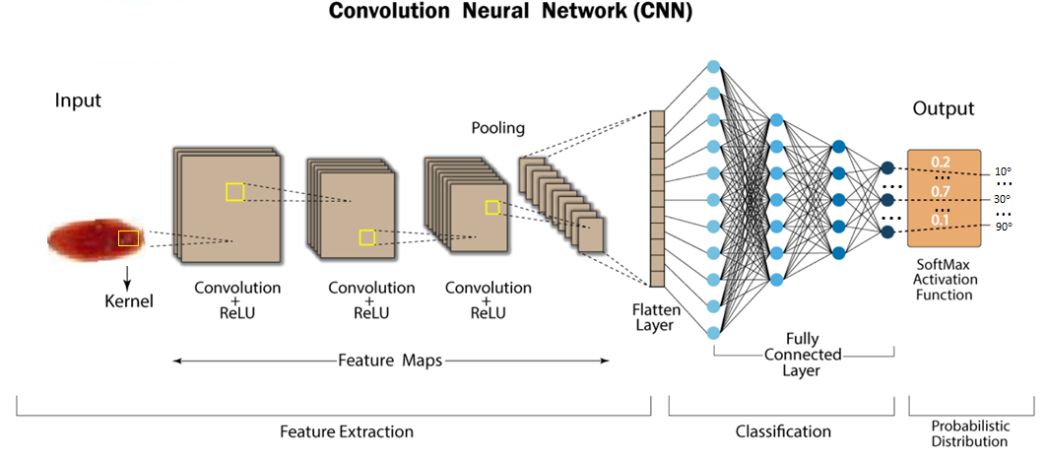
Convolutional Neural Network

Slide 10









Sample images at different impact angles
10 degrees
20 degrees
30 degrees
40 degrees
50 degrees
60 degrees
70 degrees
80 degrees
90 degrees

Slide 11
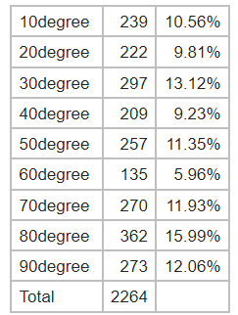
Image Statistics
Images at different impact angles and their percentages of the whole in the original dataset.

Slide 12
Process Outline
After training on the original dataset, the model yielded an average accuracy of 32.6%.
In machine learning more data is always a good thing.
In order to create a larger data set we rotated the images separately at 8 random angles .
This created a larger dataset of 20376 images in total.
After training on the larger dataset , the model yielded an average accuracy of 75.6%.

Slide 13








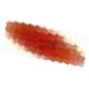
Sample image and rotations
Original image
Rotation 1
Rotation 2
Rotation 3
Rotation 4
Rotation 5
Rotation 6
Rotation 7
Rotation 8

Slide 14
Tensorflow
We used tensorflow which is a open source machine learning frame work for training models.
It was developed by Google in 2015 for internal researchand production purposes but was later adapted as an open source tool for everyone.
Tensorflow 2.0 was released in 2019.
We used tensforflow because of it’s faster computation time as compared to other machine learning libraries.

Slide 15
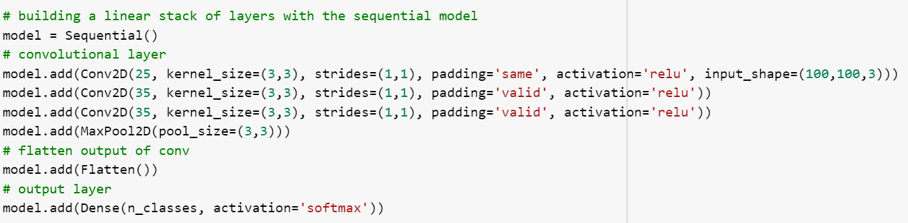
6 layer CNN

Slide 16
What is all that code doing?
The process of convolution involves a kernel or filter inside this layer moving across the receptive fields of the image, checking if a feature is present in the image.
Over multiple iterations, the kernel sweeps over the entire image. After each iteration a dot product is calculated between the input pixels and the filter.
Stride – The number of pixels shifts over the input matrix. When the stride is 1 then we move the filters to 1 pixel at a time.
Kernel size – Height x width dimensions of the kernel matrix.
Activation – is to transform the summed weighted input from the node into an output value to be fed to the next hidden layer or as output.
Padding – The amount of pixels added to an image when it is being processed by the kernel of a CNN
Flatten - Flattening is used to convert all the resultant 2-Dimensional arrays from pooled feature maps into a single long continuous linear vector.

Slide 17
Convolutional Neural Network

Slide 18
Kernel in Motion
This Photo by Unknown Author is licensed under CC BY-SA

Slide 19
Pooled Feature

Slide 20
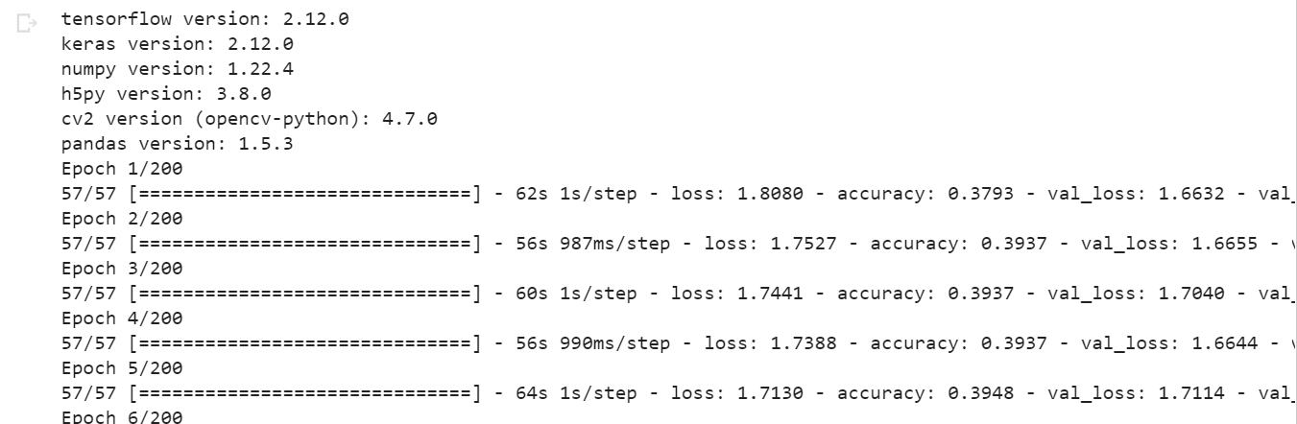
Model Run

Slide 21
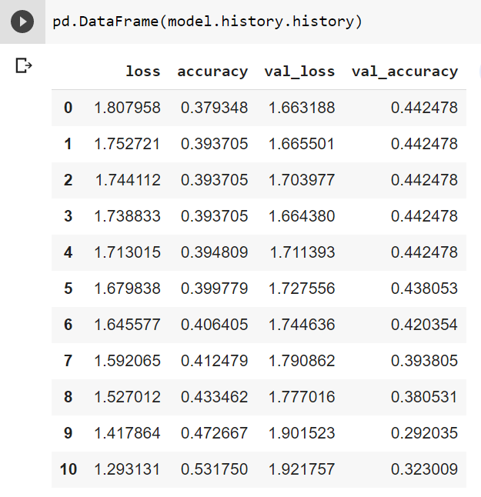
Model results on smaller non-rotated images

Slide 22
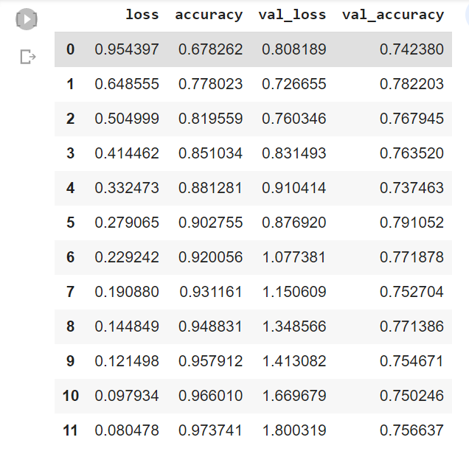
Results for model run on larger rotated dataset.

Slide 23
What’s next
Improve accuracy by training on more images by rotating images on even more angles.
Finetune hyperparameters.
Different machine learning platforms e.g.pytorch

Slide 24
Summary
Machine learning surely has a place in the field of forensics | A high accuracy CNN model can be employed for image classification and free up time for humans to concentrate their efforts elsewhere.
Though machine learning may not have been developed fully to the point where it may entirely replace human effort, there are specific tasks where when machine learning is well-employed it may better the efforts of most humans. | The success of model image classifiers could sway police departments into introducing machine learning into other specific areas of their jobs that could be well served by machine learning.

Slide 25
Additional Reading
https://mitsloan.mit.edu/ideas-made-to-matter/machine-learning-explained
https://www.ibm.com/topics/machine-learning

Slide 26
Acknowledgement
I would like to thank Dr.Fu and the department of forensics in their help with this project.

